Slide 1

Exploratory Data Analysis (EDA)
Team Collaboration & Analysis

Slide 2
Introduction
• Project Title: EDA Analysis
• Team Name: Group E
• Team Members: Presented By :- Amarnath Kommineni Kavya Gurram Sandeep Borwal Vikas Kumar Reddy
• Research Problem Overview
• Objectives of the Study

Slide 3
Dataset Name | Description
Counties_Percapita | Per capita income and housing values
Percapita_Income | County-level income statistics
Formatted_IncomeZip | Income-related data at zip-code level
County_zhvi_2bdrm | Zillow Home Value Index for 2-bedroom homes
County_zhvi_3bdrm | Zillow Home Value Index for 3-bedroom homes
Dataset Overview
Source: Zillow Website
Dataset contains multiple files with real estate and per capita income data.
Files Included:
Counties-level per capita income and housing values
Zillow Home Value Index (ZHVI) for 2-bedroom and 3-bedroom homes
Income data at the county and zip code levels

Slide 4

Key Variables and Data Structure
Categorical Features:
Geographical Identifiers: CountyName, StateName, City, Metro, RegionName
Property Type Information: RegionType, Description
Time-based attributes: Year
Numerical Features:
Economic Indicators: BasePrice, HouseValue, Increase_Percent
Statistical Indicators: ZHVI, SizeRank, StateCodeFIPS
Data Structure & Hierarchy:
Organized at multiple levels: County-level, Zip-code level, Property type-specific data
Time-Series Component: Includes yearly trends for forecasting real estate and income patterns.

Slide 5

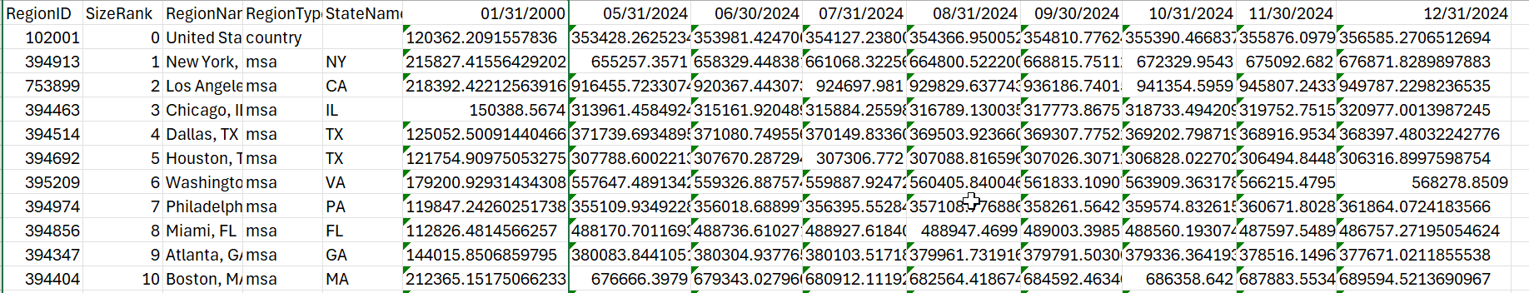
Zillow Home Value Index
ZHVI contains a measure of the typical home value and market changes across a given region and housing type. It reflects the typical value for homes in the 35th to 65th percentile range.
Source : Zillow Research Data
It contains attributes as below for 900 regions:
Region Id
Region Name
State Name
Median House Price monthly starting from 2000

Slide 6
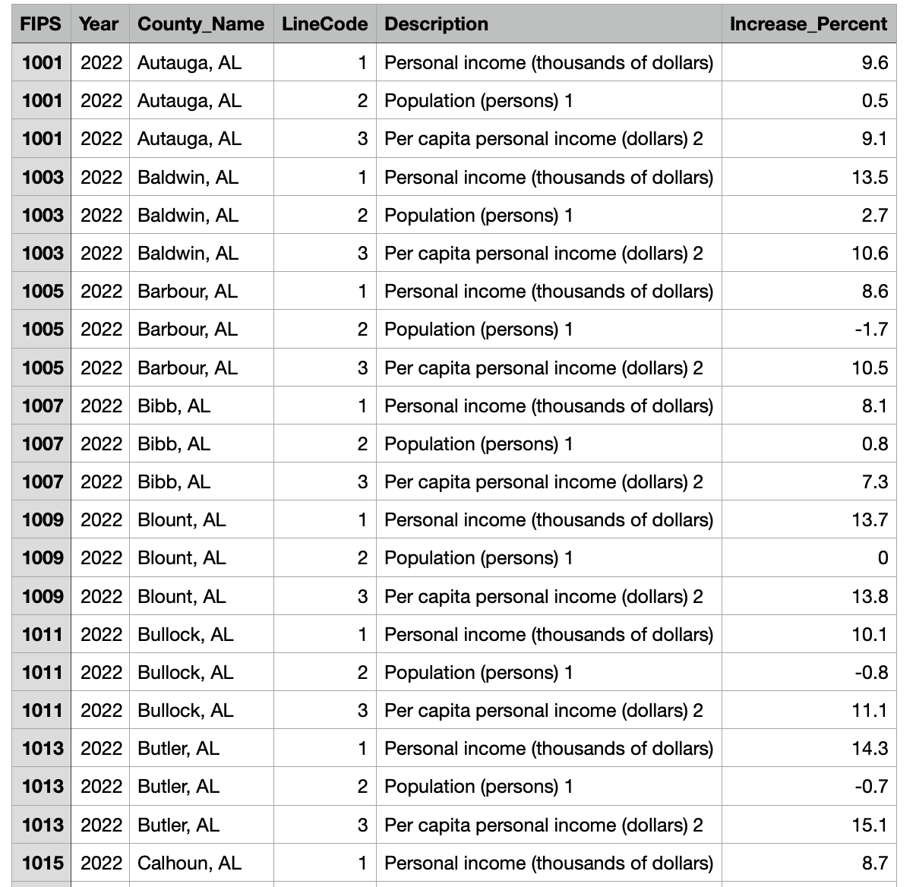

Slide 7
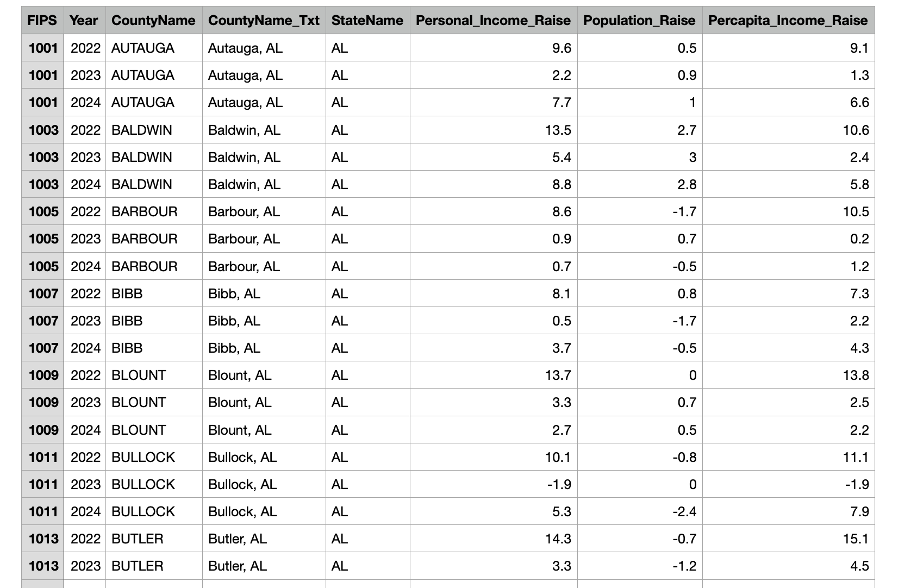

Slide 8
Data Cleaning & Handling Missing Values
Handling Missing Values
Total missing values identified across datasets:
Counties_Percapita: 18,028 missing values
County_zhvi_2bdrm: 213,101 missing values
County_zhvi_3bdrm: 227,179 missing values
Columns Dropped Due to High Missing Data:
Examples: FIPS, Personal_Income_Raise, Population_Raise
Removed monthly home value columns in some datasets.
Imputation Strategy:
Numerical Features: Filled missing values with column mean.
Categorical Features: Not applicable in this dataset.

Slide 9
Removing Duplicates & Feature Engineering
Removing Duplicates
No duplicate rows were found in any dataset.
Feature Engineering & Transformations
Normalization of Numerical Features:
Applied min-max normalization on numerical columns to scale values between 0 and 1.
Total Rows After Cleaning:
Counties_Percapita: 10,990 rows
Percapita_Income: 28,260 rows
Formatted_IncomeZip: 9,420 rows
County_zhvi_2bdrm: 2,531 rows
County_zhvi_3bdrm: 2,802 rows
Total Columns After Cleaning:
Counties_Percapita: 18 columns
Percapita_Income: 6 columns
Formatted_IncomeZip: 8 columns
County_zhvi_2bdrm: 310 columns
County_zhvi_3bdrm: 309 columns

Slide 10
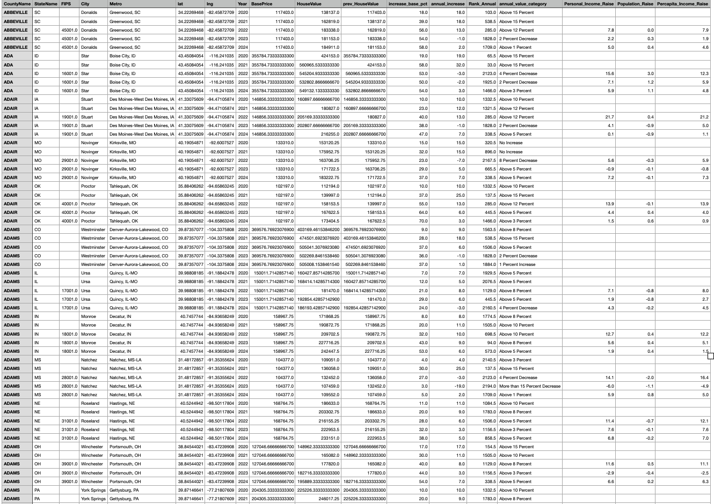

Slide 11
Exploratory Data Analysis
• Univariate & Multivariate Analysis
• Key Insights from the Data
• Statistical Summaries & Visualizations

Slide 12
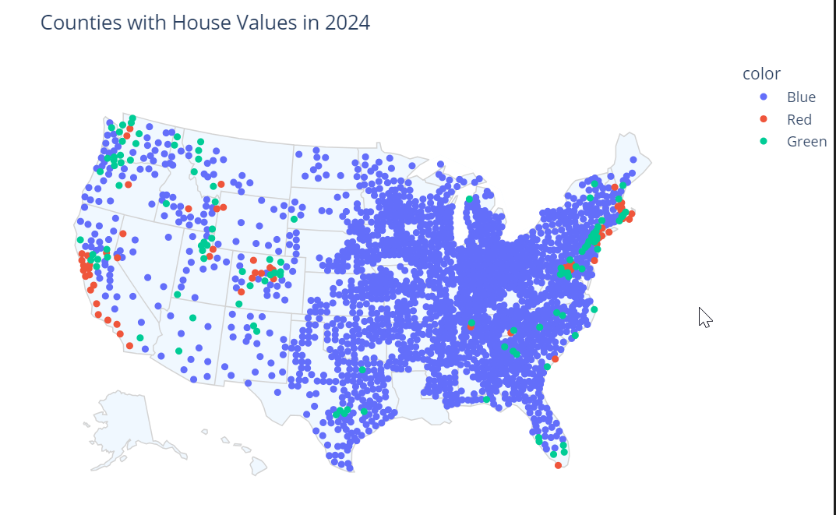
House Values of all Counties in 2024.
Counties under USA with Plot all Counties in USA Map for 2024 .
All the Ones that has Higher Prices above 700K are shown as Red.
Next High followed by Green and Economic Ones are in Blue Color.
Highlight each of dot and it shows county name .

Slide 13
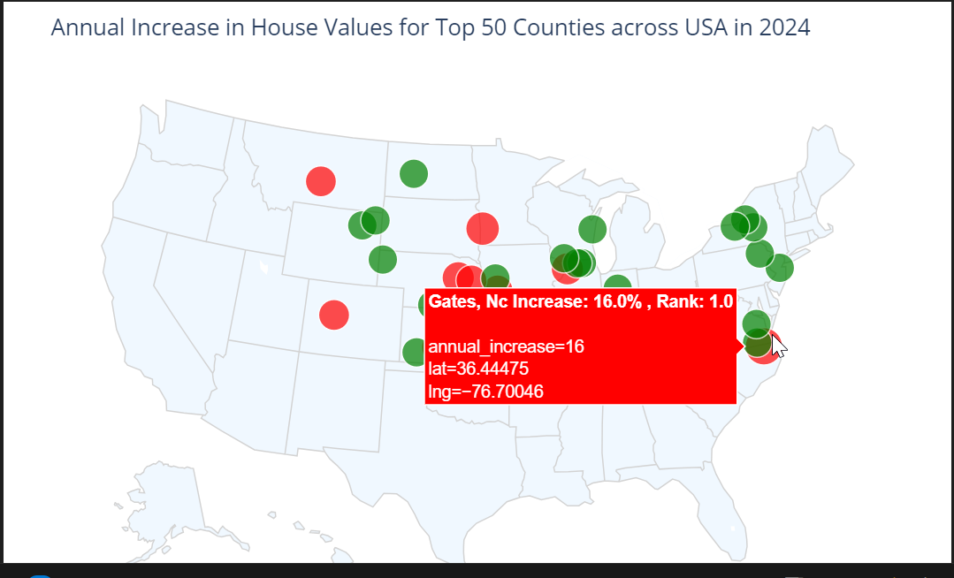
Annual Increase across all counties
Below Plot shows Annual Increase in House Values for Top 50 Counties. Each County shown with Rank, Annual Increase. Higher Annual Increase values will be shown as Red Color followed by Green with Ranks of Higher Annual Increase be 1 followed by next lower ones
Identify Yearly Percent Increase.
Annual Increase = (100 *(Previous Year Price - Current Year Price))/ Previous Year Price

Slide 14
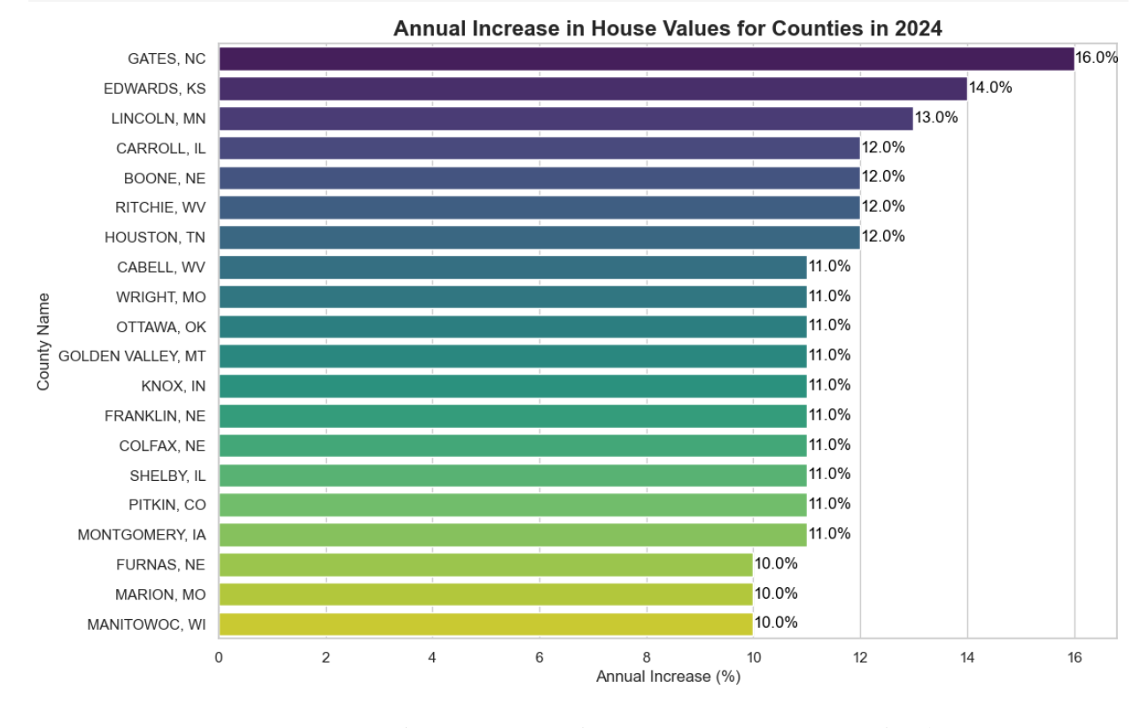

Slide 15
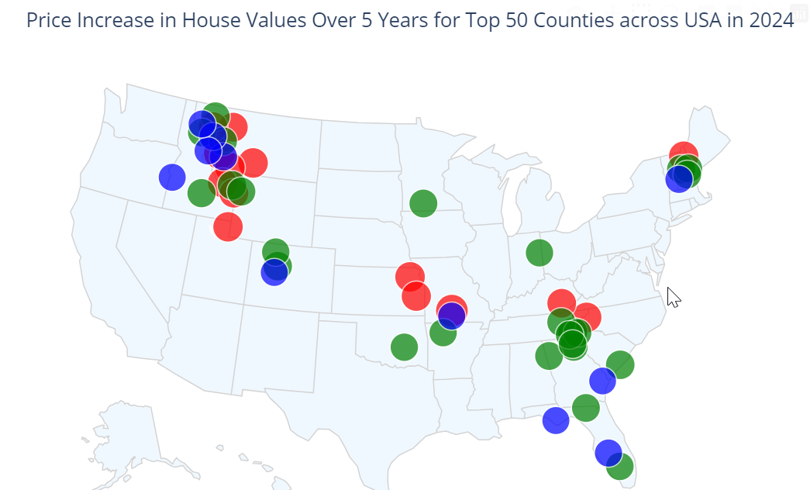
Increase in House Values over 5 Years for Top 50 Counties
Plot 5 year Percent Increase in Top 50 Counties across USA . Ones on Red that has Highest Increase. Click on Dot ; it shows % Increase.
We took 2019 as Base Price. Base Percent Increase to calculate 5 Year Percent Increase is calculated with below formula.
Base Price Increase =(100 * (Base Period Price – Current Period Price))/ Base Period Price.

Slide 16
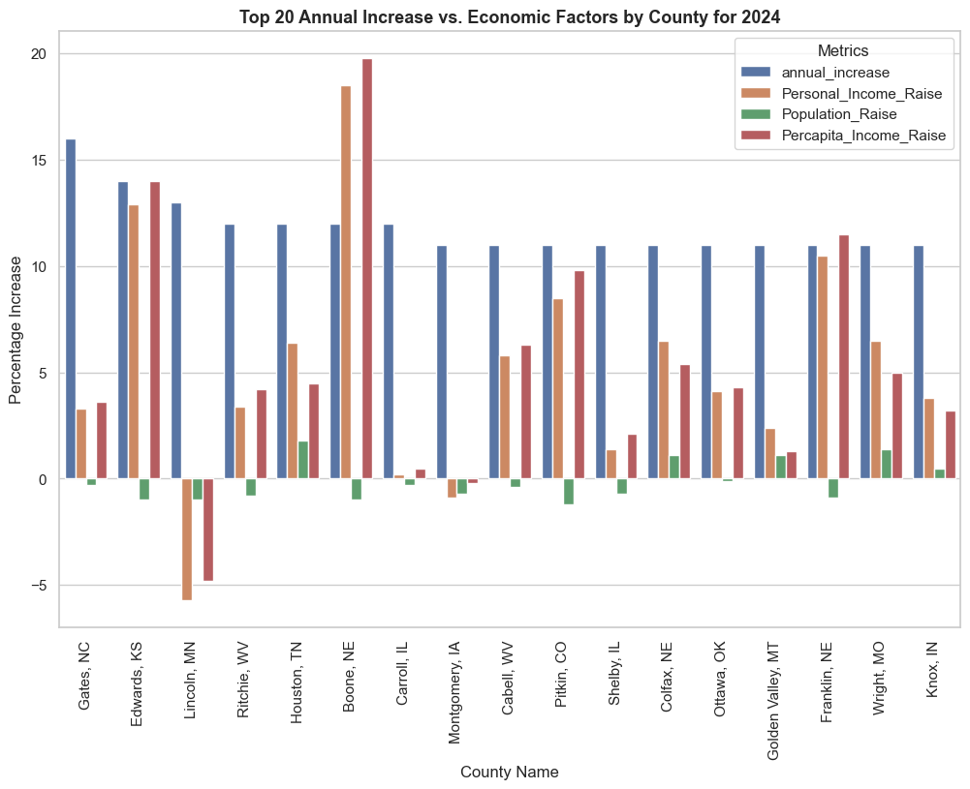
Plot Counties that has Highest Annual Increase VS Economic Factors
Based on this chart ; we cannot say that Percapita Fluctuations has direct impact on Annual Increase .
But we can state the Percapita Increase can slighthly impact Housing Price Annual Increase.
This suggests population Increase might be contributing to the household income Increase.
But there is anamoly that Lincoln MN has Personal Income Raise as Negative despite Household Increase.

Slide 17
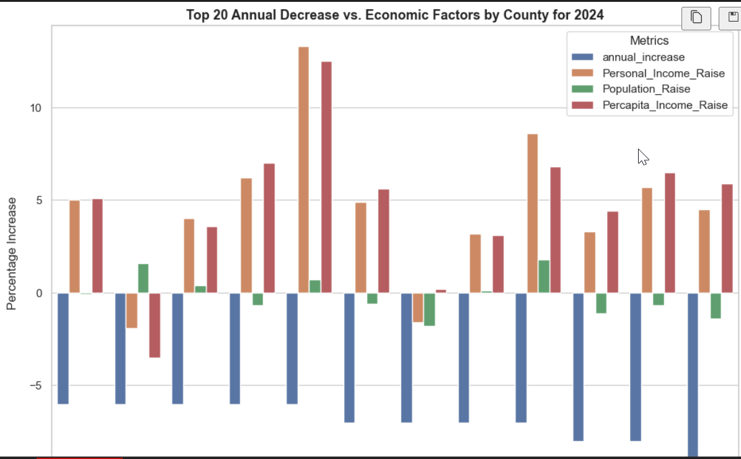
Plot Counties that has Highest Annual Decrease VS Economic Factors
Plot Top 20 Counties that has Highest Annual Decrease vs Economic Factors in 2024. Based on this chart ; we cannot say that Percapita Fluctuations has direct impact on Annual Increase or Decrease.
But we can state the Percapita Increase can slighthly impact Housing Price Annual Increase.
This suggests population Increase might be contributing to the household income Increase.
This suggests population decline might be contributing to the household income decrease

Slide 18
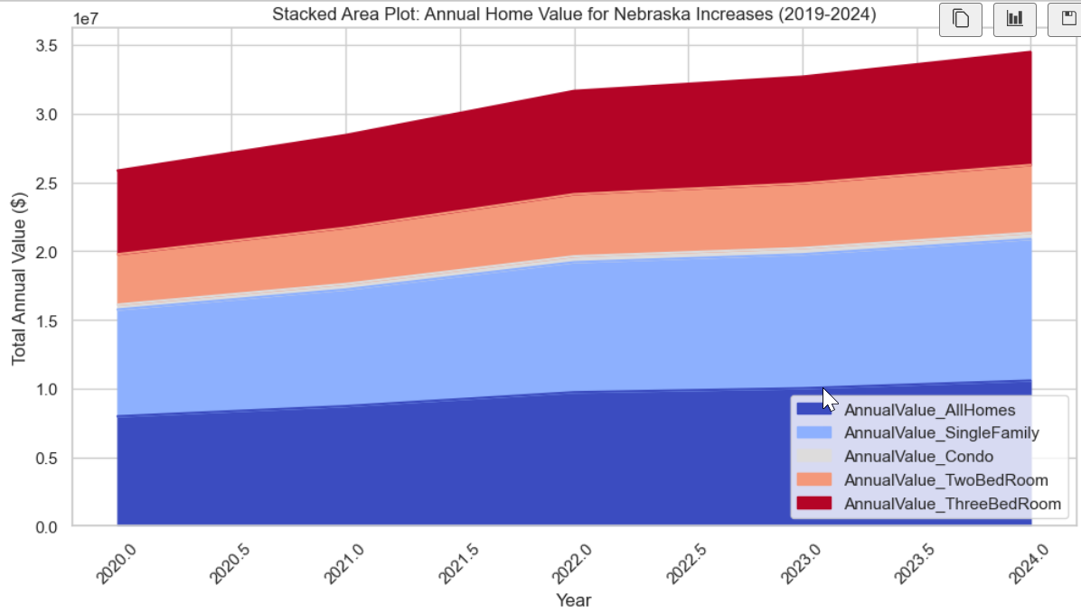
Stacked Area Plot for Nebraska
This Stacked area Plot for Nebraska shows consistent upward trend in annual home values across all categories.
Dominance of All Homes and Single Family Homes as they form base of stack and show most significant growth.
Also shows significant contribution from Two and Three Bed rooms.Condo category shows least amount of growth compared to other categories.
Slope of stacked area suggesting steady and sustatined growth rate in home values.

Slide 19
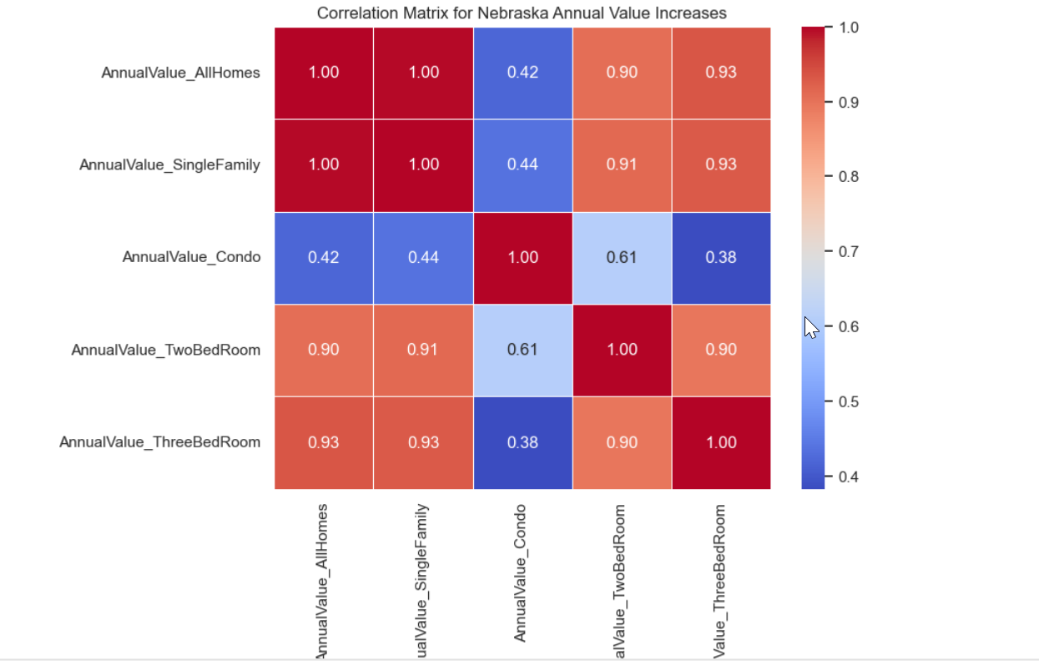
Correlation Heat Map for Counties across Nebraska
Correlation Plot shows strong correlation between AllHomes , Single Family , Tow Bedroom and ThreeBedroom with Positive values and close to 1.
This indicates when one of these annual categories increase the others tend to increase as well.
This shows conistent overall trend ; when one segment is doing well others tend to follow.
Condos show weaker correlation with other categories across Nebraska. This suggest Condos are not much preferable.

Slide 20
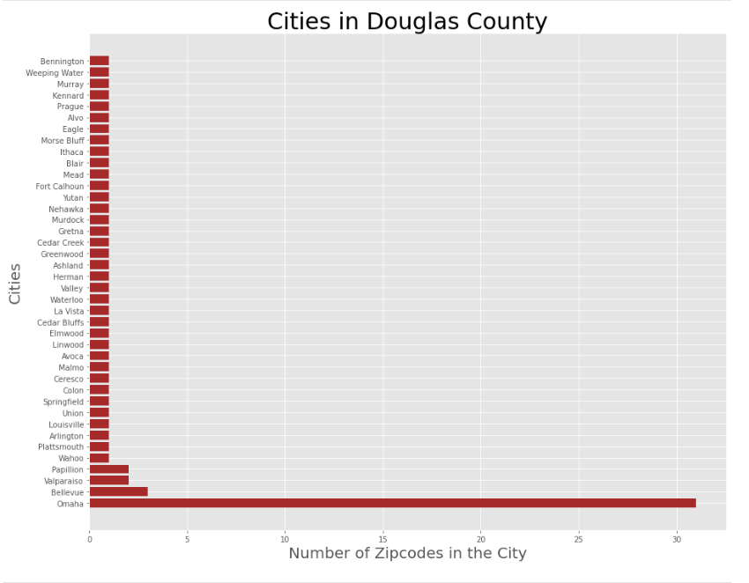
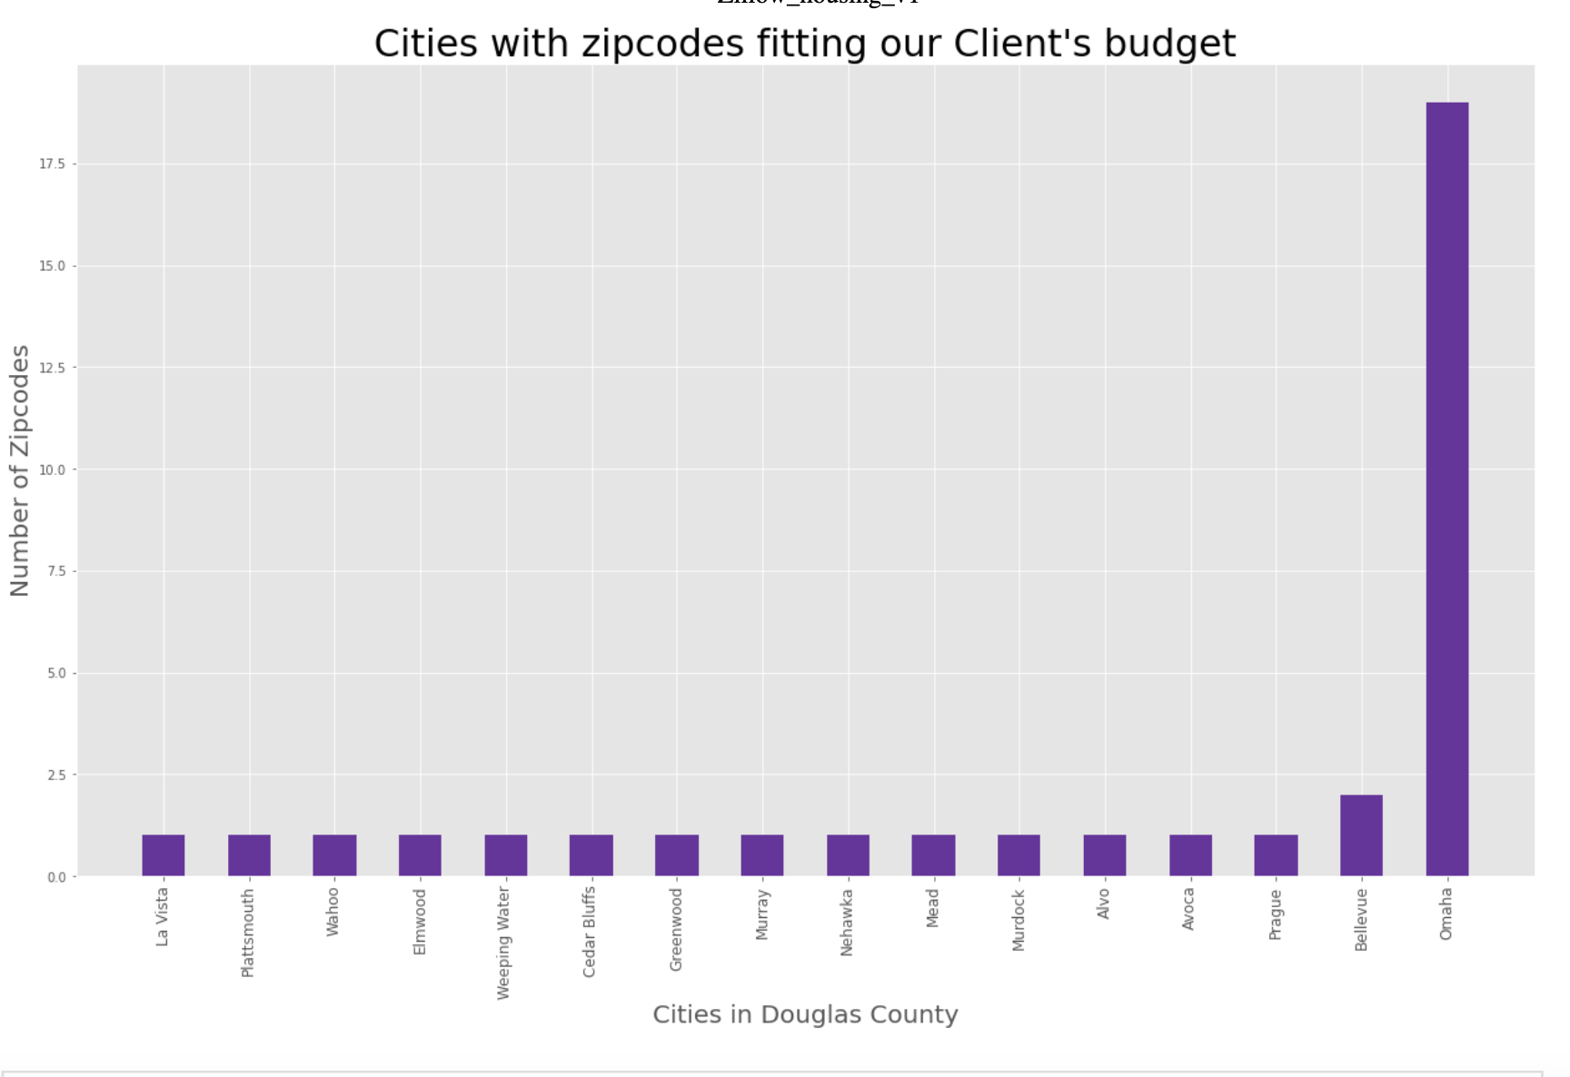
Omaha Has the highest number of zip codes, close to 30, indicating it is the
largest city in terms of zip code distribution. Bellevue Follows with around 3 zip codes.
Other Cities Cities like Valley, Waterloo, and Bennington have fewer than three zip codes each.
Smaller Cities Most other cities listed have only one or two zip codes.

Slide 21
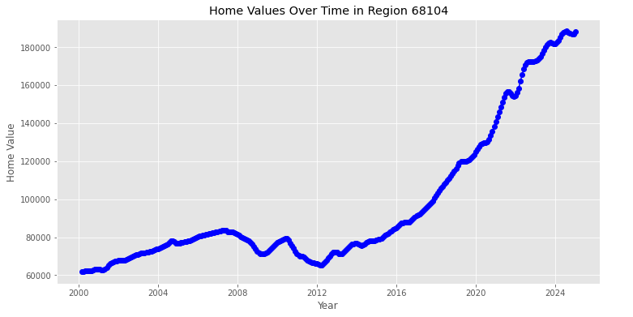
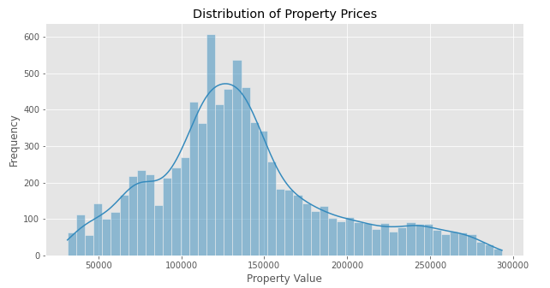

Slide 22
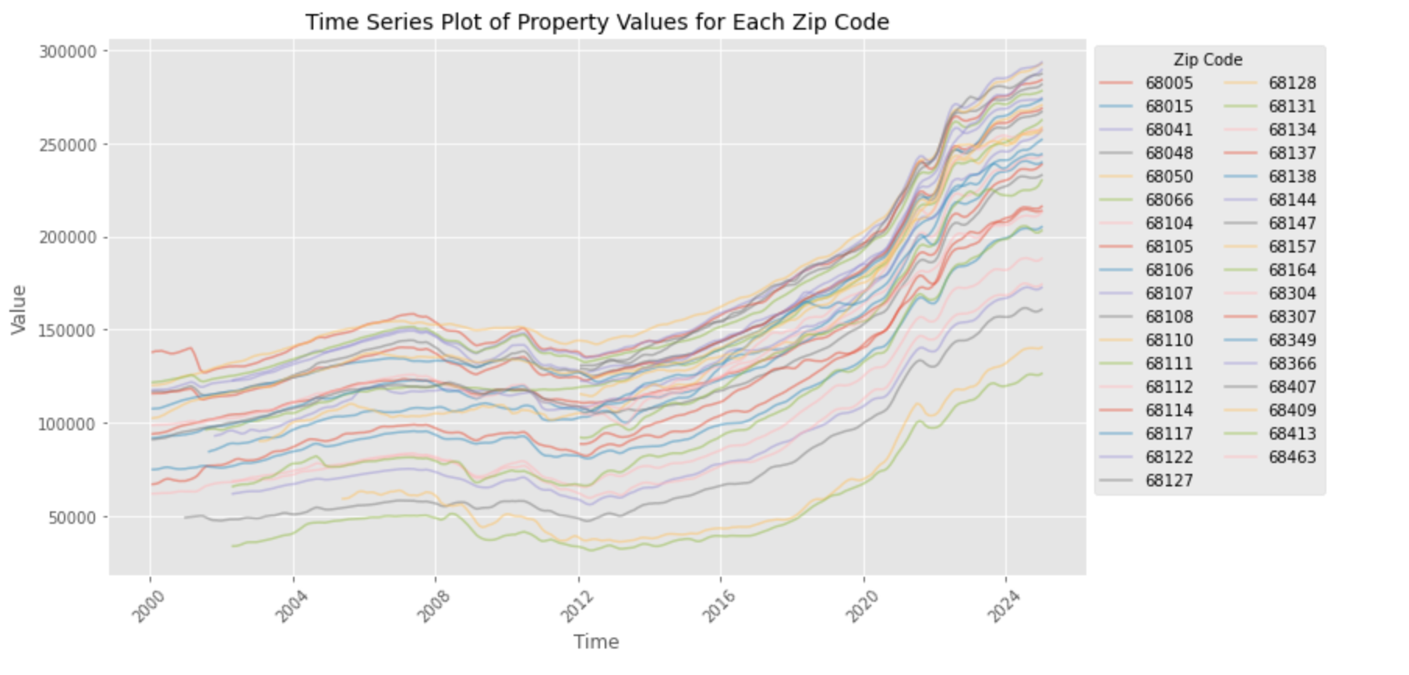
Multiple Lines: Each line on the chart corresponds to a different zip code,
showing how property values have changed over time for each zip code.
Trends: Most lines show an increase in property values over the period, particularly after 2012.
This indicates a general upward trend in property values for the zip codes included in the chart.
Legend: The legend on the right side lists the zip codes, helping to identify which line
corresponds to which zip code.

Slide 23
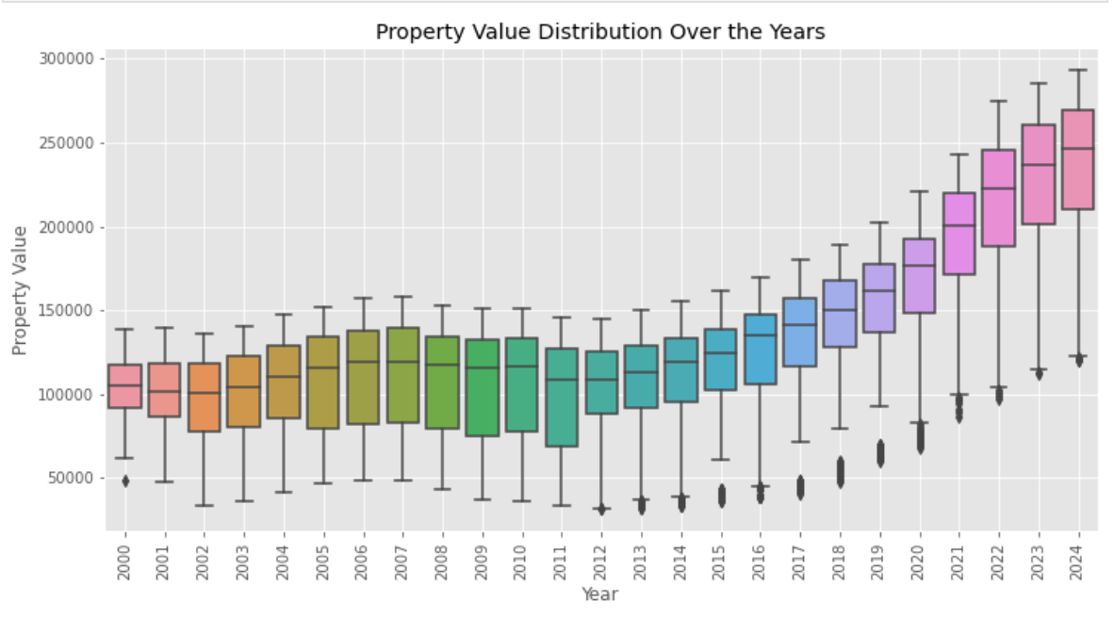
Increasing Property Values: Property values have generally increased over time from 2000 to 2024. -->
Variability: There is noticeable variability in property values each year, with some years showing wider I
QRs than others. -->Rising Median Values: Median property values have risen consistently over this period, indicating an overall upward trend in property prices. -->Outliers: Present in most years, suggesting that there are some properties with significantly higher or lower values compared to the majority.

Slide 24
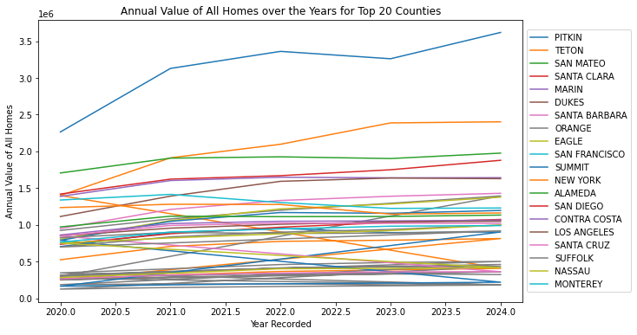

Slide 25
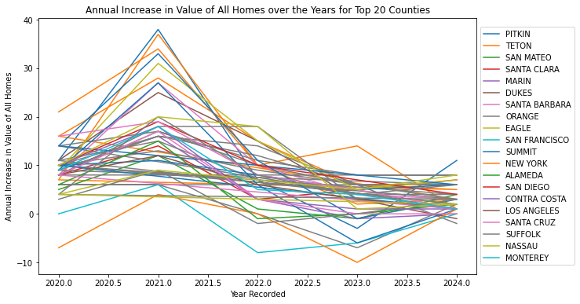

Slide 26
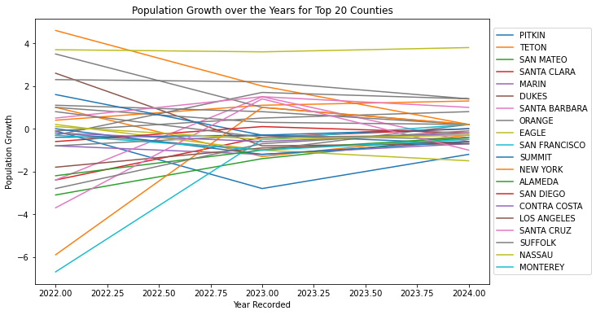

Slide 27
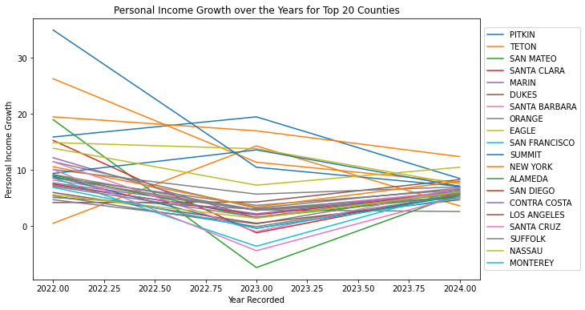

Slide 28
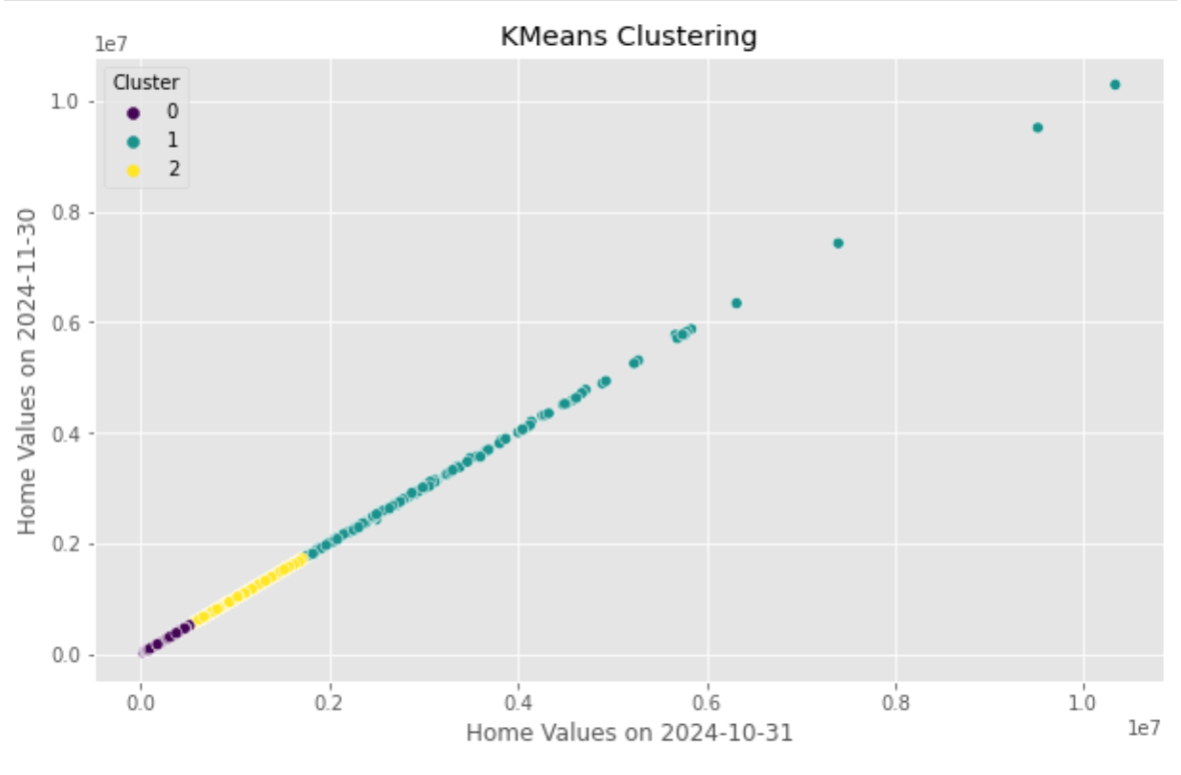
The chart is a scatter plot showing the results of KMeans clustering on home values from two different dates: 2024-10-31 and 2024-11-30.
Cluster 0 (yellow): This cluster has a dense concentration along the diagonal line,indicating that for these homes, the values remained relatively stable between the two dates.
Cluster 1 (purple): This cluster also follows a similar pattern but is more spread out compared to Cluster 0.
Cluster 2 (green): This cluster shows a wider distribution with some outliers indicating significant changes in home values between the two dates.
The diagonal trend suggests that most homes did not experience drastic changes in value over this one-month period. - Outliers in each cluster indicate homes that had significant increases or decreases in value.

Slide 29
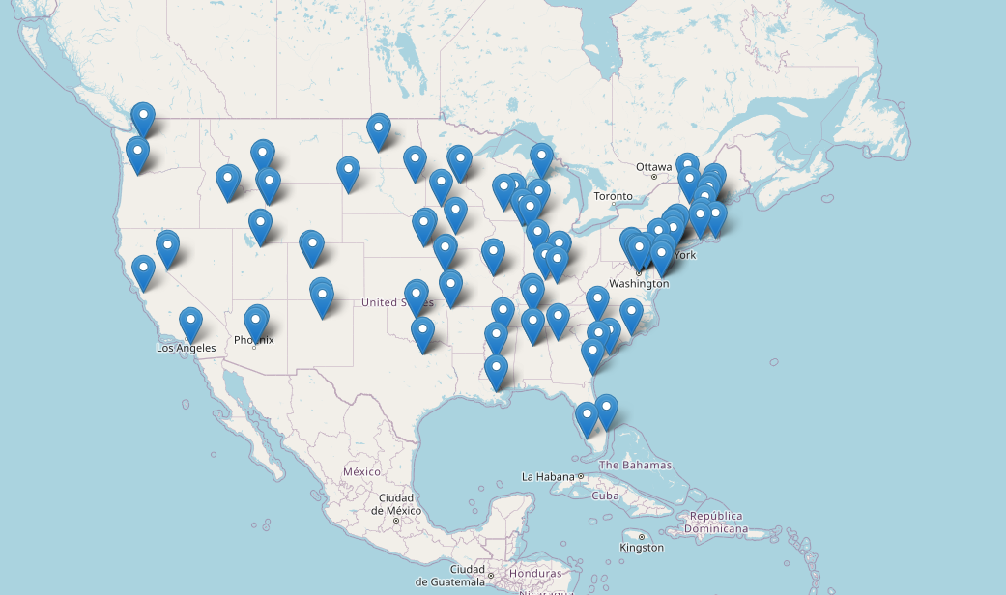
the above USA map shows top two cities for each state which has highest values as of date 2024-12-31

Slide 30
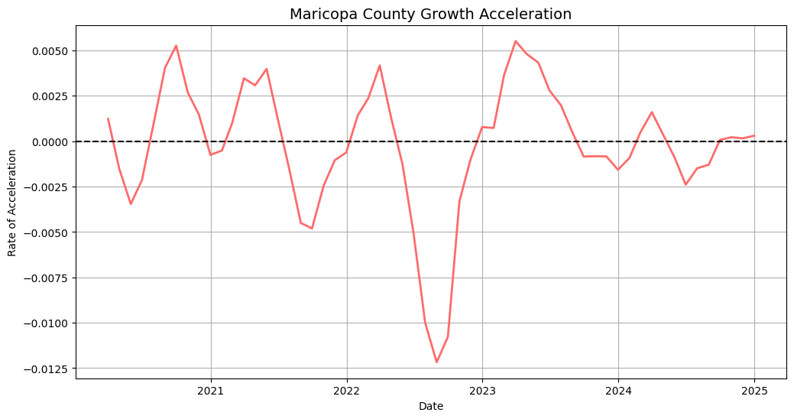
Growth Acceleration Analysis (Maricopa County)

Slide 31
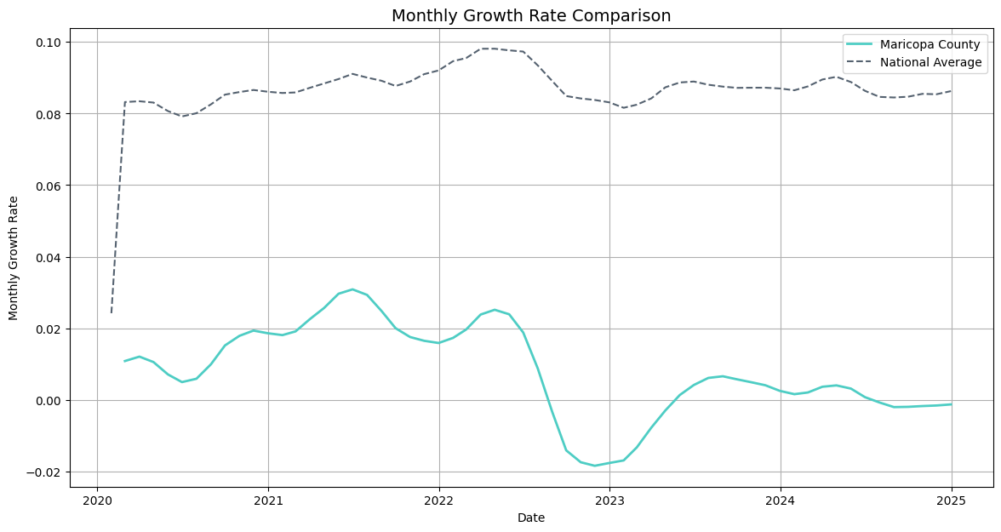

Slide 32
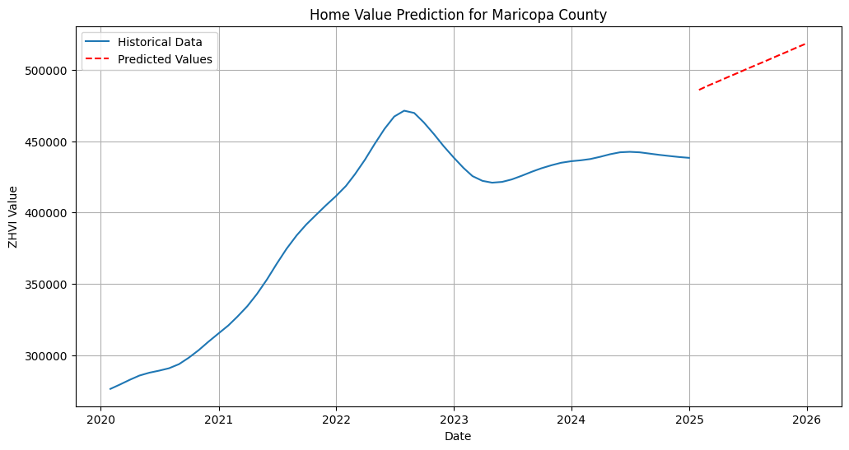
Predicting Future Home Values
A linear regression model is employed to predict future home values in Maricopa County. By using historical trends, the model estimates home values for the next 12 months.

Slide 33
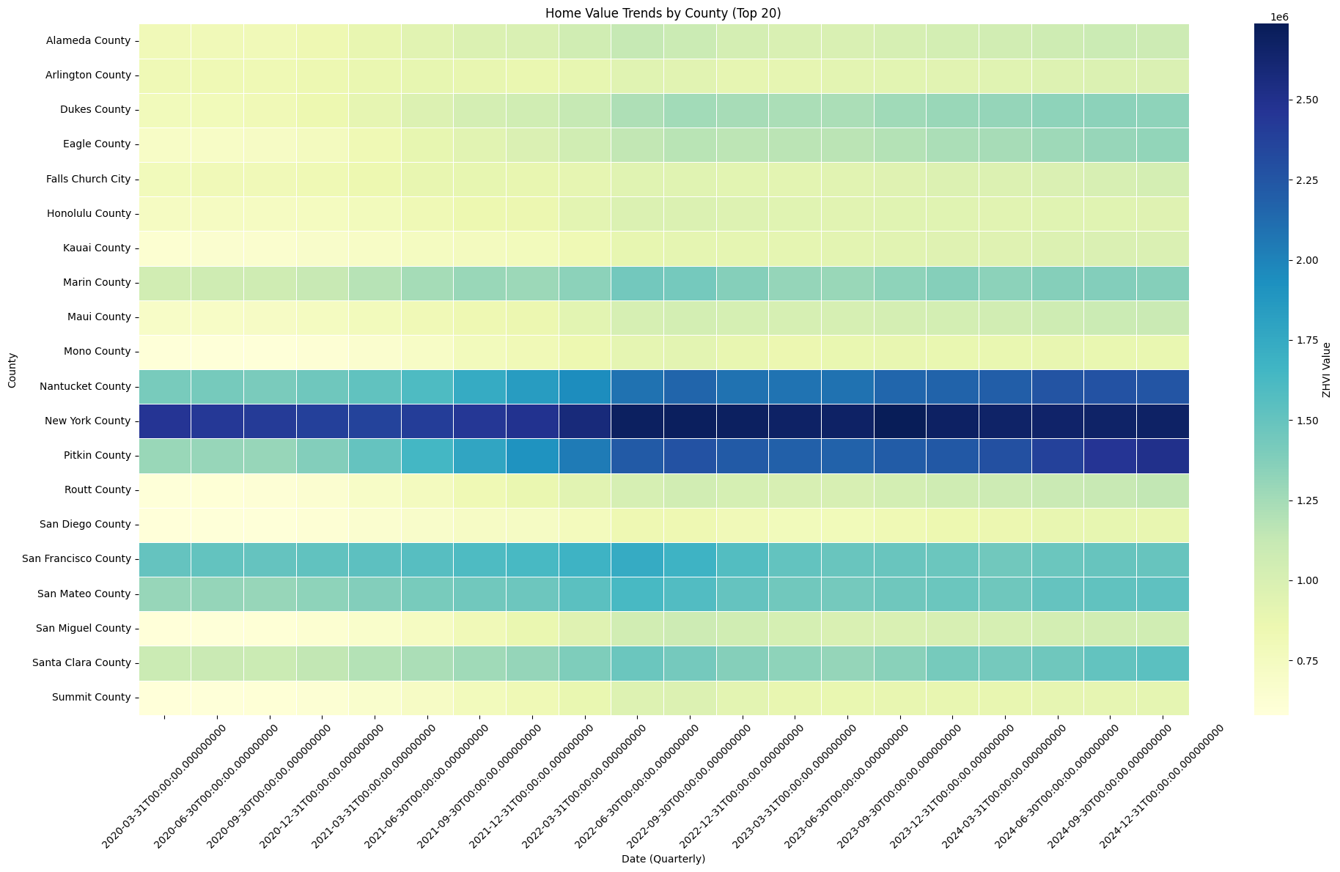
Heatmap of Home Values Across Counties
To visualize regional differences in home value trends, a heatmap is generated, showing how home values have evolved across counties over time.

Slide 34
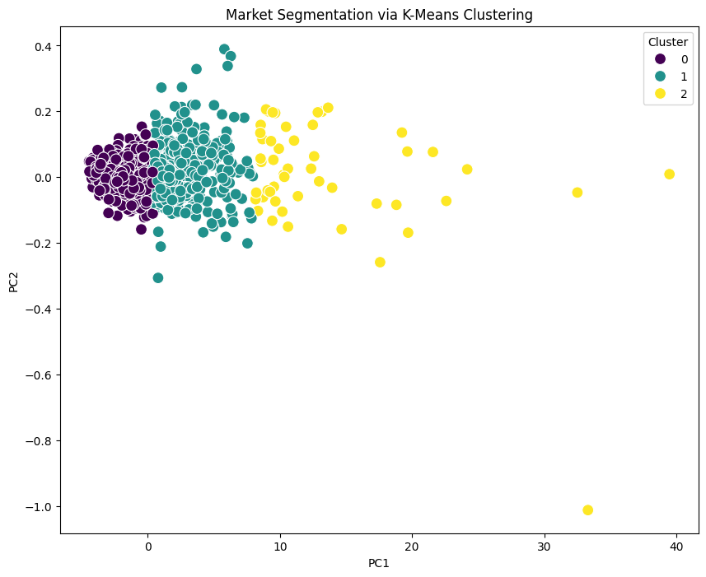
K-Means Clustering for Market Segmentation
K-Means clustering groups counties based on ZHVI patterns, identifying three distinct market segments.
This analysis helps classify housing markets into distinct categories, which can be useful for investors and policymakers.

Slide 35
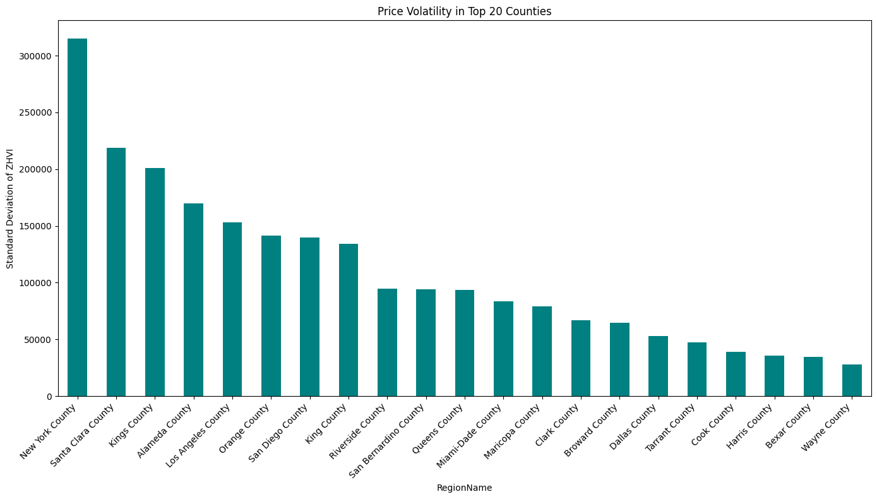
Price Volatility Analysis
Standard deviation of ZHVI values across different counties is calculated and visualized as a bar chart. High volatility suggests fluctuating home prices, while low volatility indicates stable markets. This insight is valuable for investors seeking either high-risk, high-reward opportunities or stable investment zones.

Slide 36
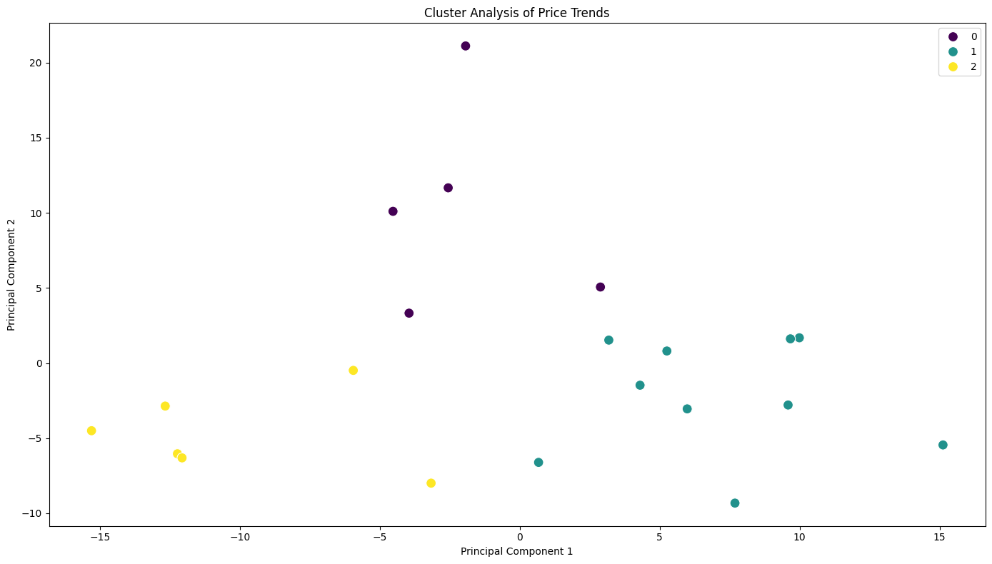

Slide 37
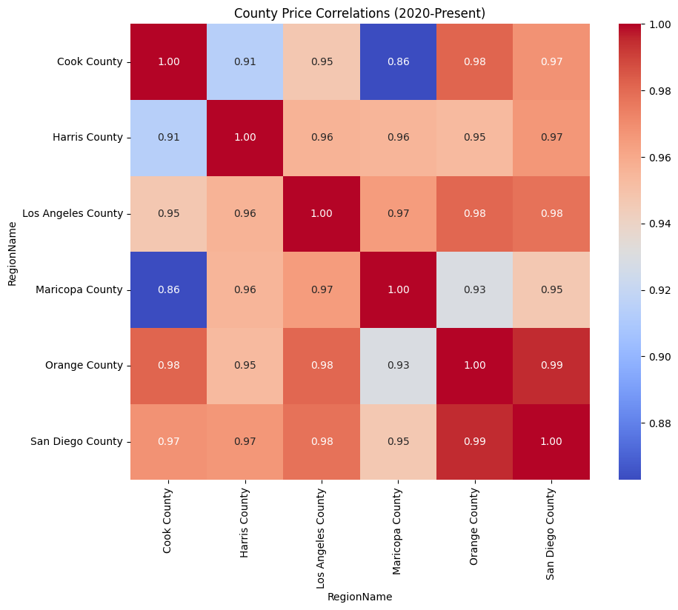
County-Wise Correlation Matrix
A heatmap of the correlation matrix shows relationships between housing markets in different counties. High correlation values suggest synchronized price movements, while low correlations indicate independent trends.

Slide 38
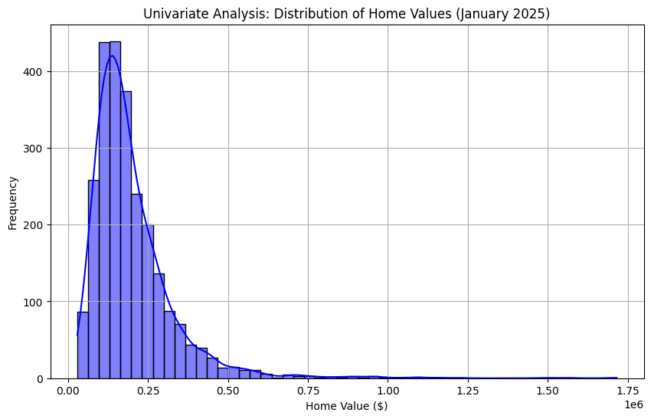

Slide 39
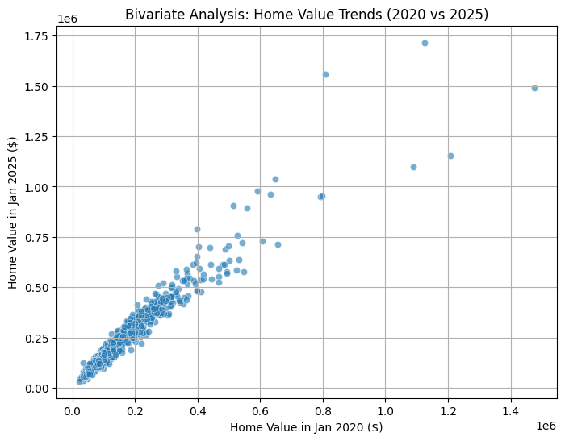

Slide 40
• Issues Encountered in EDA
- High Missing Values in some datasets, requiring imputation or removal.
- Data inconsistencies found in categorical variables (e.g., 'Metro', 'CountyName').
• Data Quality and Feature Limitations
- Limited categorical variables affecting regional property insights.
- Gaps in time-series data requiring interpolation.
- Aggregation mismatches between county-level and zip-code-level data.
• Assumptions Made
- Missing numerical values assumed to follow similar distributions.
- Min-max scaling applied for feature normalization.
- Assumed property trends represent market behavior without external influences.

Slide 41
Further Data Processing & Model Implementation
• Feature Engineering Enhancements
- Apply transformations like log scaling, polynomial features.
- Investigate variable interactions for improved insights.
• Model Selection & Training
- Identify the different models
- Train baseline models
- run the model for accuracy and get the results.
-Finalize the best model method to be used.

Slide 42
Thank You

